Slide 1


IT4043E
Big Data
Storage & Processing
GROUP
4
TAXI TRIP ANALYSIS SYSTEM FOR NYC TLC YELLOW TAXI RECORDS

Slide 2
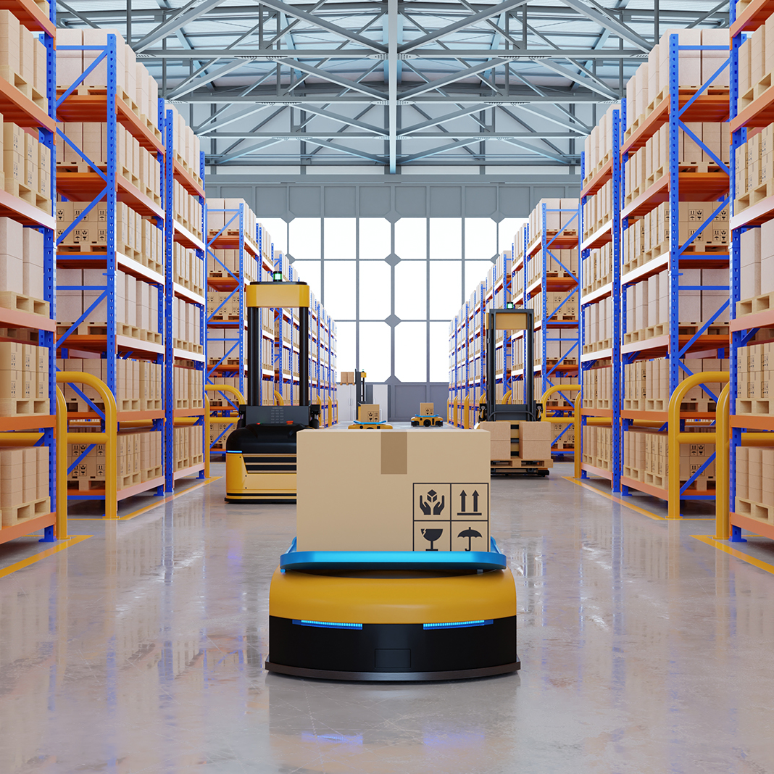

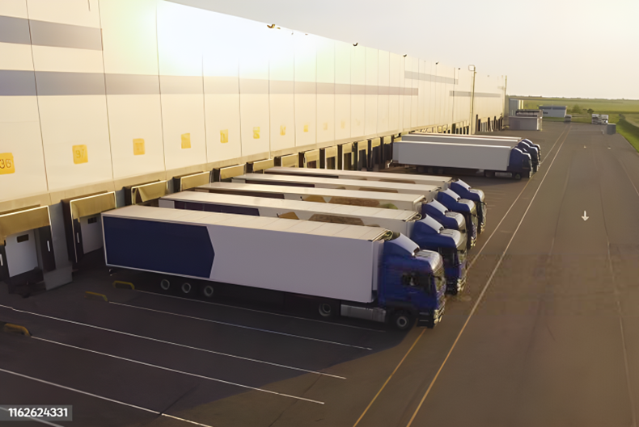
Problem Overview
Motivation & Problem Definition

Slide 3
Defining features of our problem
Dataset
NYC TLC Yellow Taxi Trip Records
Millions of trips / year for 17 years (2009 – present)
Motivation
Understand city-wide taxi demand patterns
Optimize routes, fares, fleet allocation
Applying Big Data storage & processing techniques
Monthly NYC TLC Taxi Data publicly avaliable on https://www.nyc.gov/site/tlc/
Problem Definition
Design and implement a scalable data-processing architecture capable of ingesting, storing, and analyzing NYC Taxi Trip data to extract useful statistics and insights in real time or near-real time.

Slide 4
Dataset Exploration
Dataset Fields, Qualitative & Quantitative Descriptions

Slide 5
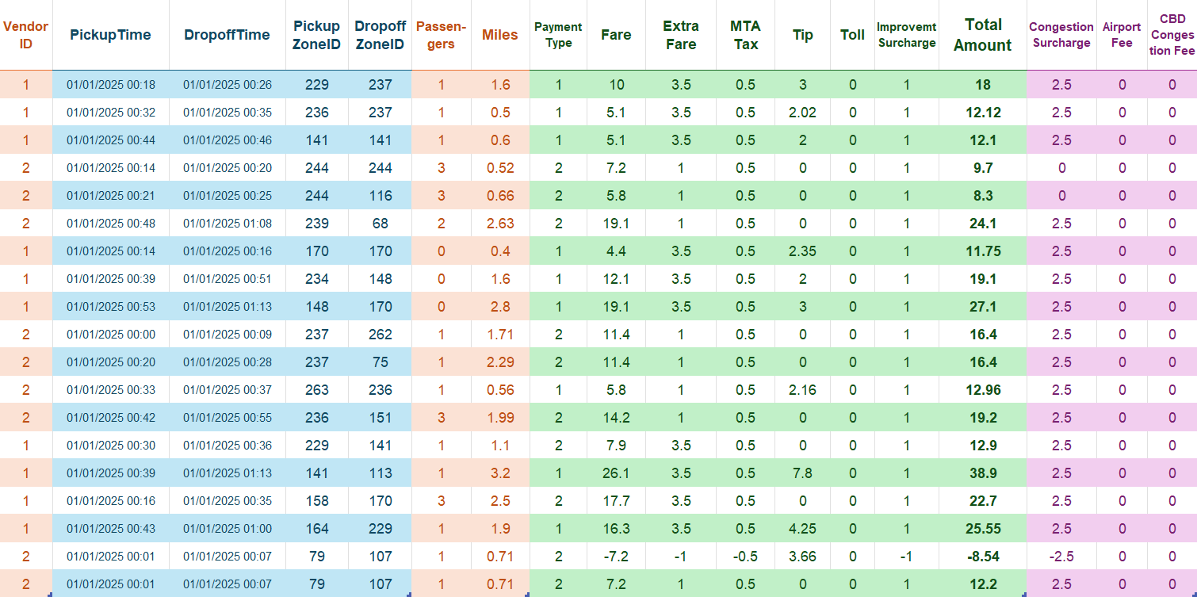
Dataset Description
Figure 2
Sample Data Points from the NYC TLC Yellow Taxi Trip Records
Pickup & Dropoff
Trip
Fares & Fees
Other Fees

Slide 6
Dataset Description
Pickup & Dropoff
Includes Date, Time and Location (Zone ID)

Slide 7
Dataset Description
Trip Info
Includes Number of Passengers and Miles Travelled

Slide 8
Dataset Description
Fare & Fees
Includes Payment Information, Fare and various Fees

Slide 9
Dataset Description
Other Fees
Includes Miscancellaneous Fees

Slide 10
Dataset Coverage & Qualitative Analysis
Dataset Coverage
Temporal: January 2009 – Present (by month)
Spatial: All five boroughs of New York City
Granularity: Each file (~55MB) contails millions of trip-level records
Format: Parquet files We will simulate real-time events and perform analysis on a subset of this dataset.
Qualitative Features
High volume (hundreds of millions of rows) – ideal for distributed storage like HDFS.
Continuous velocity (can simulate real-time ingestion) – fits Kafka streaming.
Diverse variety (categorical, numerical, temporal data) – good for multi-perspective analytics.
High veracity (official, regulated data) – reliable for decision-making.

Slide 11
General Architecture
Components and Data Pipeline

Slide 12
Components Overview
Layer | Technology | Purpose
Message Queue | Apache Kafka | Simulate and ingest trip events
Batch Processing | Spark Batch (PySpark) | Periodic data aggregation from HDFS
Streaming Processing | Spark Structured Streaming | Real-time analytics from Kafka
Distributed Storage | HDFS | Store raw and curated historical data
Database | Cassandra (NoSQL) | Store aggregated results for live querying
Visualization | Grafana | Live + static dashboards

Slide 13
Components Overview
Layer | Technology | Purpose
Message Queue | Apache Kafka | Simulate and ingest trip events
Streaming Processing | Spark Structured Streaming | Real-time analytics from Kafka
Distributed Storage | HDFS | Store raw and curated historical data
Database | Cassandra (NoSQL) | Store aggregated results for live querying
Visualization | Grafana | Live + static dashboards

Slide 14
Data Pipeline Summary
Stage | Input | Processing
Ingestion | TLC Yellow Taxi CSV/Parquet | Kafka producer simulates streaming
Batch Layer | HDFS (raw zone) | Spark Batch (aggregations, caching, joins)
Stream Layer | Kafka topic | Spark Streaming (watermark, UDF, window ops)
Visualization | Cassandra/HDFS | Grafana dashboard

Slide 15








Architecture Diagram – Lambda Architecture
Data Source
Speed Layer
Batch Layer
Stream
Raw Dump
Hadoop HDFS
Aggregates
Read
Spark Batch
JSON
Correct
Query
Trigger
Data Source
Scheduler
Notes:
Real-Time Streaming/Ingestion Layer
This layer sits closest to the data source and is responsible for ingesting (and often buffering) large volumes of event/stream data in real time or near-real time. It decouples the producers of data from the processors, provides durability, ordering/partitioning, and makes data available to downstream systems. It also enables re-play of data, back-pressure handling, and helps provide a reliable foundation for streaming analytics. For example, you might capture clickstreams, sensor data, transactions, logs, etc. Uses of this layer:
Buffering, partitioning, persisting streaming events so they aren’t lost if downstream slows.
Providing a streaming log/topic abstraction from which processing engines consume.
Enabling multiple downstream consumers (fan‐out) or replay/debug.
Enabling ingestion from disparate sources into a unified stream platform.

Slide 16

Next Steps
Formulating Immediate and Long-term Plans

Slide 17
Planning for Upcoming Weeks
Stream pipeline: Kafka → Spark → Cassandra
Batch pipeline: HDFS → Spark → Grafana
Integrate Cassandra–Grafana
Build dashboards & alerts
Performance test & finalize demo

Slide 18
Thank you!

